Slide 1
Oxford Robot car dataset implement
Self driving car group

Slide 2
Outline
Data Description
Equipment Description (camera, LIDAR, GPS)
Result
Image Demosaicing and Undistortion
3D Point cloud Generation
Point cloud Projection Into Images

Slide 3
Data Description
From Oxford robot car project
1 GB Sample data
Lidar
2D Lidar (x, y, R) 2D Cartesian coordinates
3D Lidar (x, y, z) 3D Cartesian coordinates
Camera
Images
GPS
Pose information (x, y, z, α, β, γ)
image from: http://robotcar-dataset.robots.ox.ac.uk/images/file-tree.png

Slide 4
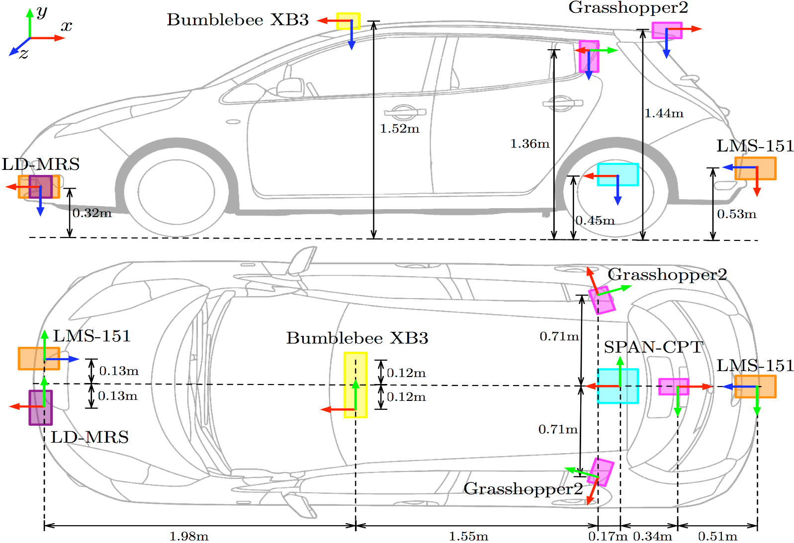
Equipment Description
http://robotcar-dataset.robots.ox.ac.uk/documentation/

Slide 5
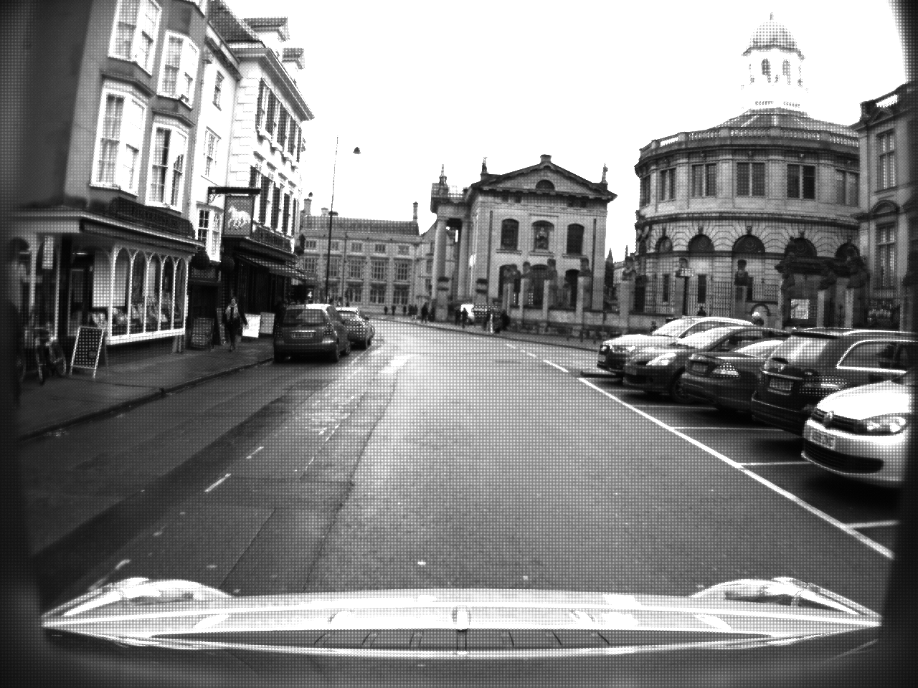
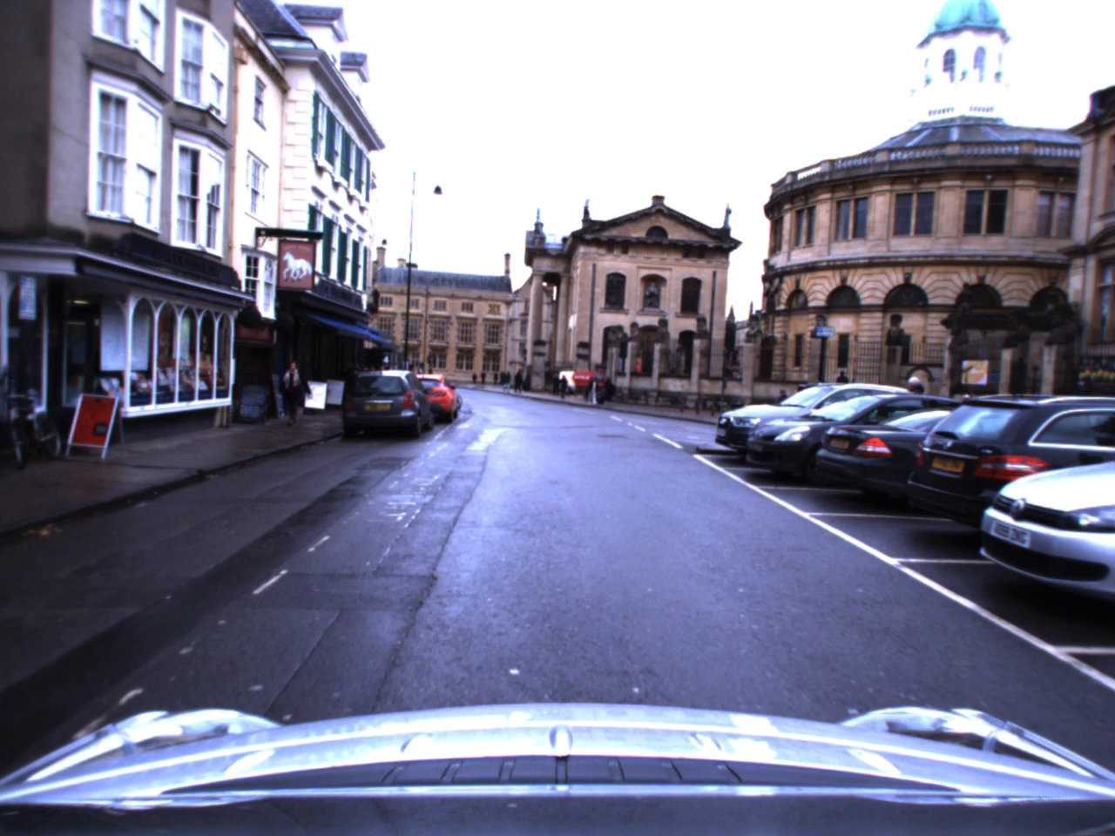
Result Image Demosaicing and Undistortion
Image before processing
Image after processing

Slide 6
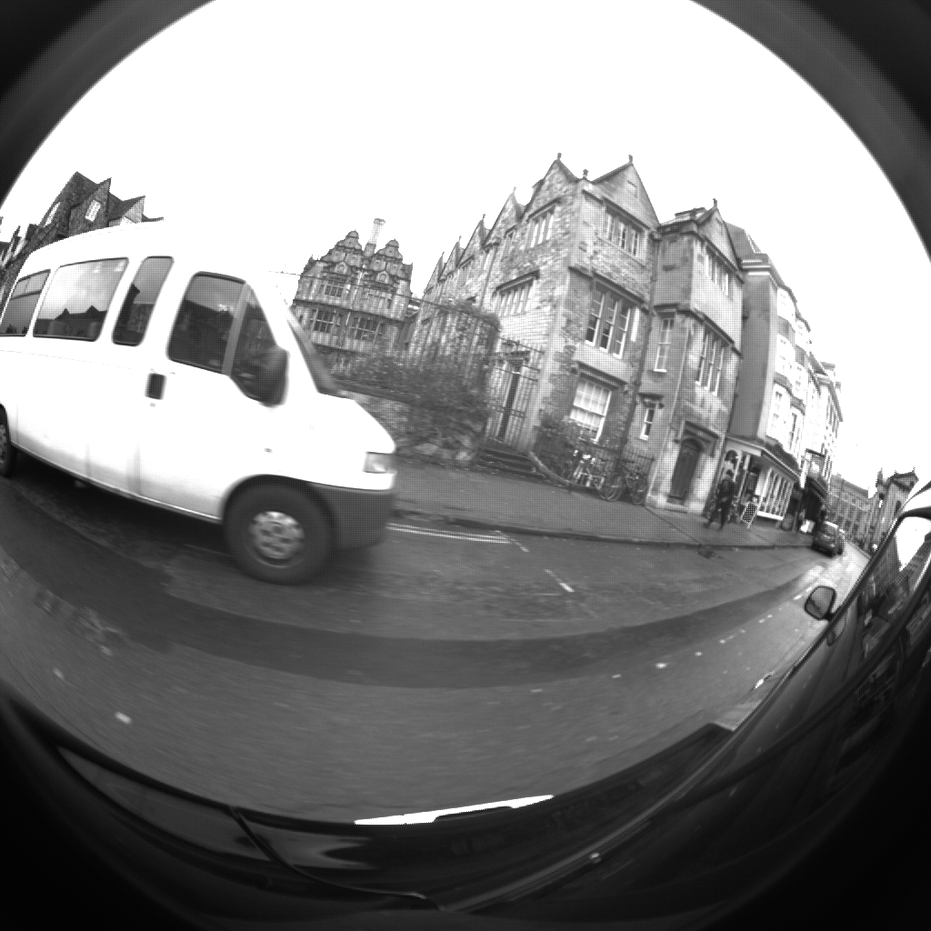
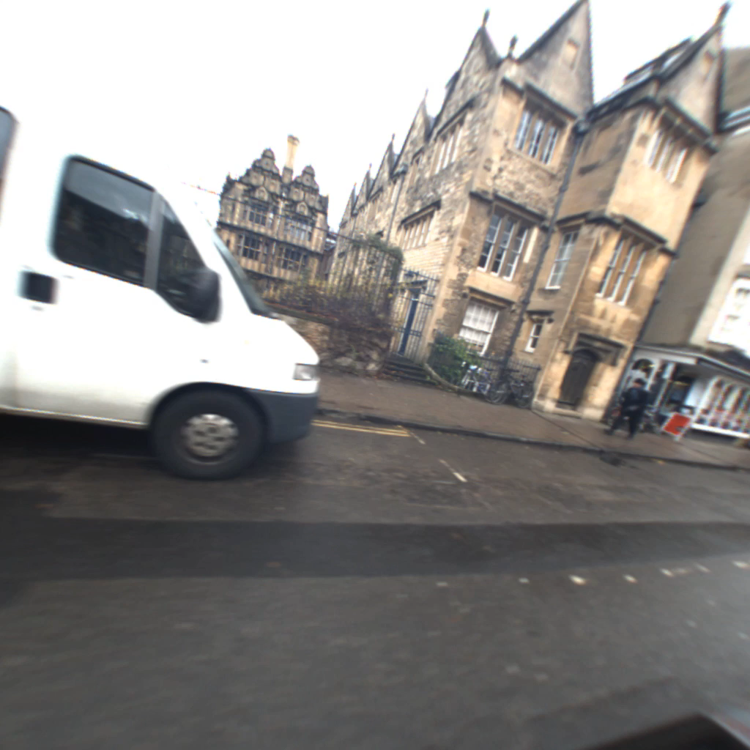
Result Image Demosaicing and Undistortion
Image before processing
Image after processing

Slide 7
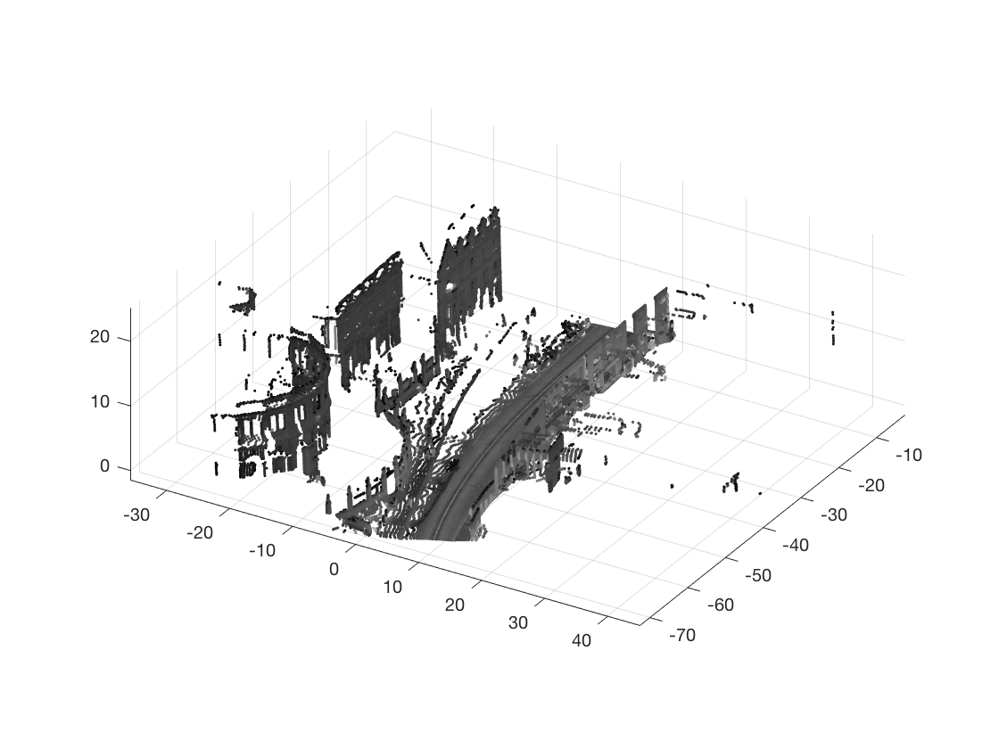
Result 3D Point cloud Generation
Front 2D LIDAR
Rear 2D LIDAR

Slide 8
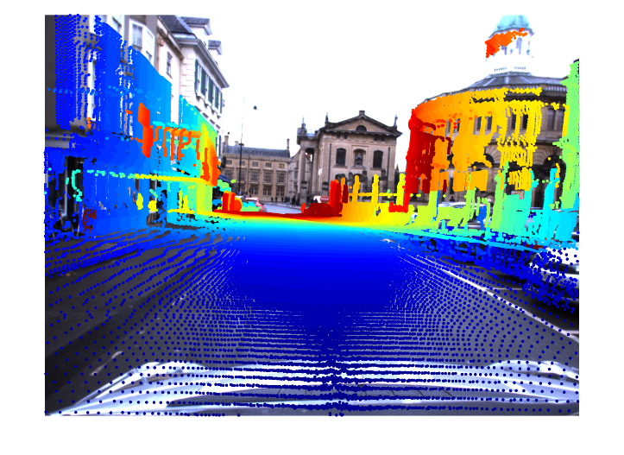
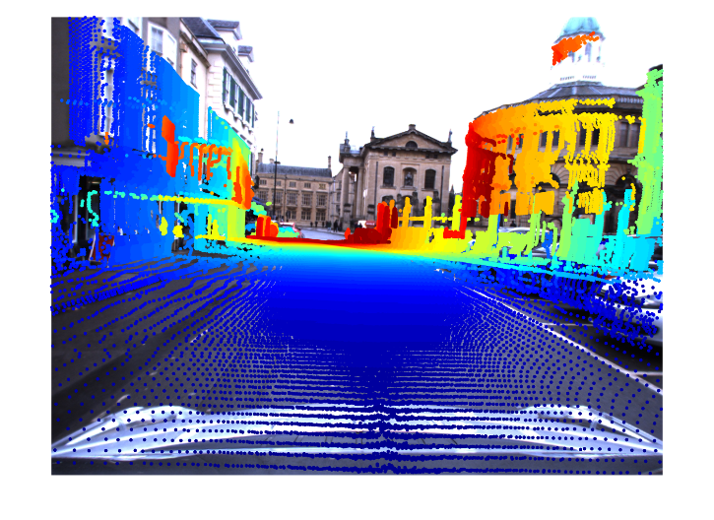
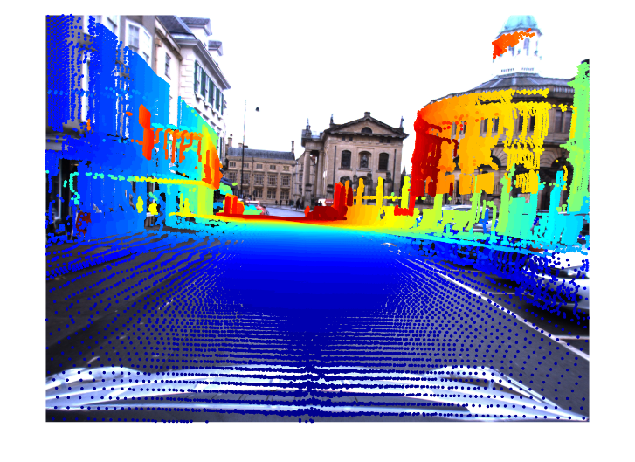
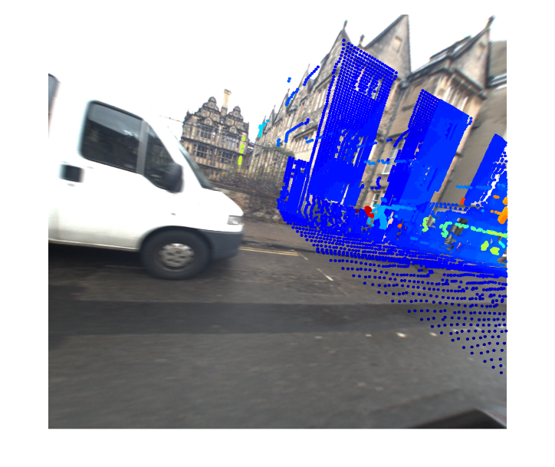
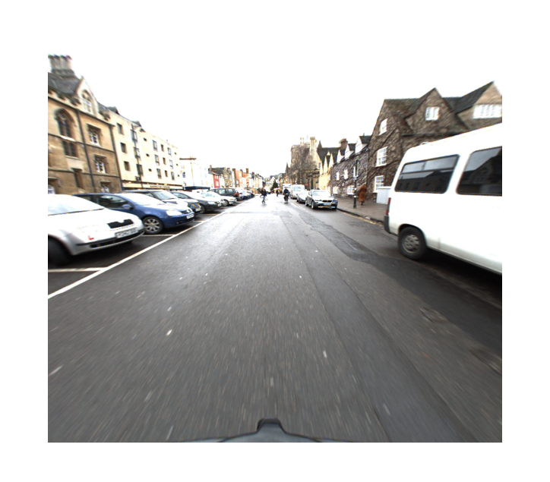
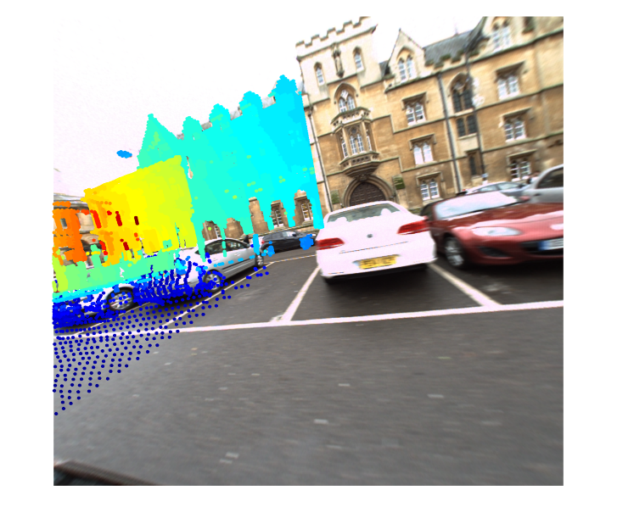
Result Point cloud Projection Into Images
Stereo_left
Stereo_centre
Stereo_right
Mono_left
Mono_rear
Mono_right

Slide 9
Reference
Data Resource:
http://robotcar-dataset.robots.ox.ac.uk/
Development Kit:
https://github.com/oxfordrobotics/robotcar-dataset-sdk/tree/master/matlab
W. Maddern, G. Pascoe, C. Linegar and P. Newman, "1 Year, 1000km: The Oxford RobotCar Dataset", The International Journal of Robotics Research (IJRR), 2016.

